Slide 1
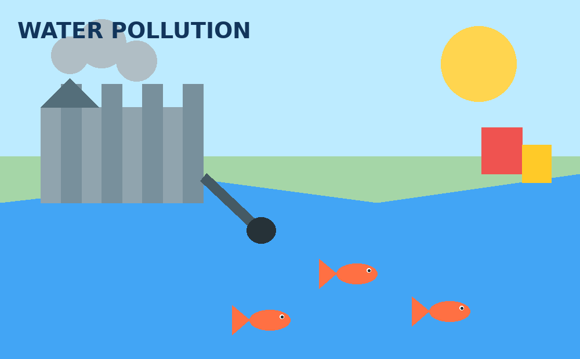
WATER AND
SOIL POLLUTION
Environmental Studies
Sources • Effects • Treatment • Conservation
1

Slide 2
Topics Covered
From syllabus
1
Water pollution: definition, sources, pollutants and characteristics
2
Control measures and effects on humans, plants and animals
3
Water treatment and wastewater treatment processes
4
Water (Prevention and Control of Pollution) Act, 1974
5
Water conservation and rainwater harvesting
6
Soil pollution: causes, effects and preventive measures
2

Slide 3
4.1 Water Pollution: Definition and Sources
Definition
Water pollution is the contamination of surface water or groundwater that changes its physical, chemical or biological quality and makes it harmful or unfit for intended use.
Major sources
• Domestic sewage and municipal waste
• Industrial effluents
• Agricultural runoff
• Oil, plastics and solid waste
Point vs non-point
Point source: discharge from an identifiable outlet such as a pipe.
Non-point source: diffuse runoff from farms, roads and urban areas.
3

Slide 4
4.2 Types of Water Pollutants
Physical
Chemical
Biological
Colour, odour, turbidity, suspended solids
Acids, salts, nutrients, metals, pesticides
Bacteria, viruses, protozoa, parasites
Radioactive
Thermal
Plastic / solid waste
Radioisotopes from medical, industrial or nuclear sources
Hot-water discharge that raises water temperature
Plastic bags, bottles, microplastics and floating debris
4

Slide 5
4.3 Characteristics of Water Pollutants
Biodegradable
Non-biodegradable
Can be broken down by microorganisms; excess can deplete oxygen.
Persist for long periods, e.g., many plastics and some toxic chemicals.
Toxic
Nutrients
Can harm humans and aquatic organisms even at low concentrations.
Nitrogen and phosphorus can cause eutrophication and algal blooms.
Oxygen-demanding
Persistent / bioaccumulative
Organic matter increases BOD/COD and reduces dissolved oxygen.
Some pollutants build up in organisms and food chains.
5

Slide 6
4.4 Control Measures of Water Pollution
Reduce at source
Treat sewage
Treat industrial effluent
Control farm runoff
Reuse & recycle water
Enforce standards
• Use cleaner production methods and minimize waste generation.
• Install sewage treatment plants (STPs) and effluent treatment plants (ETPs).
• Prevent dumping of plastics, oils and chemicals into water bodies.
• Promote buffer strips, balanced fertilizer use and integrated pest management.
• Regular monitoring, public awareness and strict enforcement are essential.
6

Slide 7
4.5 Effects of Water Pollution
Human health
Aquatic life
Water-borne diseases, poisoning, skin problems and long-term health risks.
Fish kills, reduced dissolved oxygen and habitat destruction.
Ecosystems
Economy
Algal blooms, eutrophication and loss of biodiversity.
Higher water-treatment costs and losses to fisheries and tourism.
7

Slide 8
4.6 Effects on Plants and Animals
Effects on plants
Effects on animals
• Toxic metals can inhibit growth.
• Polluted irrigation water can damage crops.
• Excess nutrients cause abnormal algal growth.
• Soil and water chemistry may change.
• Low dissolved oxygen can suffocate fish.
• Toxins may bioaccumulate in tissues.
• Reproduction and growth can be affected.
• Food chains can be disrupted.
Pollution
Less oxygen
Stress / death
Biodiversity loss
8

Slide 9
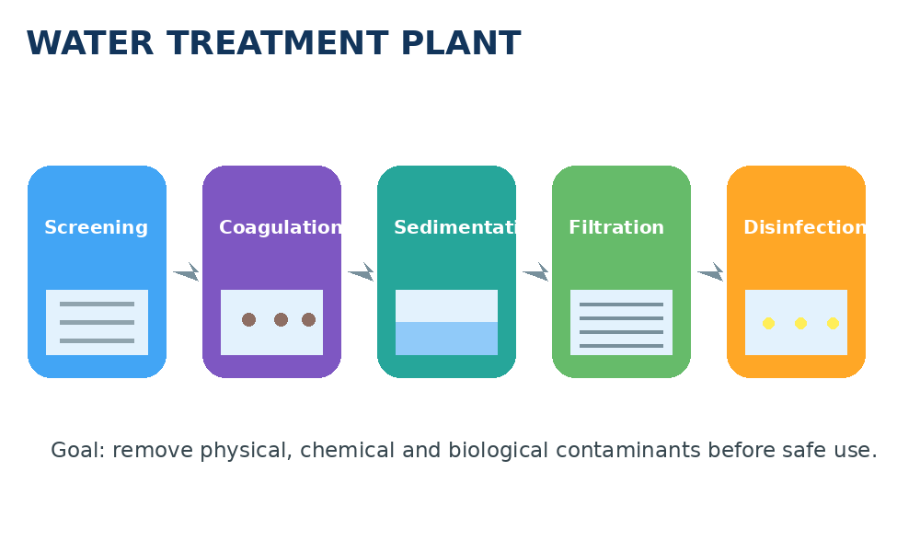
4.7 Water Treatment Process
9

Slide 10
4.8 Unit Operations in Water Treatment
Screening
Aeration
Coagulation
Flocculation
Removes large floating objects.
Adds oxygen and removes some gases/odour.
Destabilizes fine particles.
Forms larger flocs for easy settling.
Sedimentation
Filtration
Disinfection
Storage
Settles suspended particles.
Removes remaining fine particles.
Kills or inactivates pathogens.
Provides contact time and supply balance.
10

Slide 11
4.9 Wastewater Treatment Process
Preliminary
Primary
Secondary
Tertiary
Disinfection / Reuse
• Preliminary treatment: screening and grit removal.
• Primary treatment: sedimentation removes settleable solids.
• Secondary treatment: microorganisms remove biodegradable organic matter.
• Tertiary treatment: removes nutrients, fine solids and specific pollutants.
• Final disinfection may be used before discharge or reuse.
11

Slide 12
4.10 Unit Operations in Wastewater Treatment
Bar screen
Grit chamber
Primary clarifier
Aeration tank
Large solids
Sand and grit
Settleable solids
Biological treatment
Secondary clarifier
Filter
Disinfection
Sludge handling
Biomass separation
Fine particles
Pathogen control
Thickening, digestion and disposal
12

Slide 13
4.11 Water (Prevention and Control of Pollution) Act, 1974
Purpose
Pollution Control Boards
Provides a legal framework to prevent and control water pollution and maintain the wholesomeness of water.
Creates/strengthens Central and State Pollution Control Boards to monitor pollution and implement the Act.
Consent mechanism
Importance
Certain industries/discharges require consent from the pollution control authority before establishing or operating.
Encourages standards, monitoring, legal action and coordinated pollution-control measures.
13

Slide 14
4.12 Water Conservation & Rainwater Harvesting
What is it?
Collecting and storing rainwater from rooftops or open areas for later use or groundwater recharge.
Importance
Reduces pressure on groundwater, improves water availability and reduces storm-water runoff.
Storage tank
Methods
Rooftop collection • Recharge pits • Recharge wells • Storage tanks
14

Slide 15
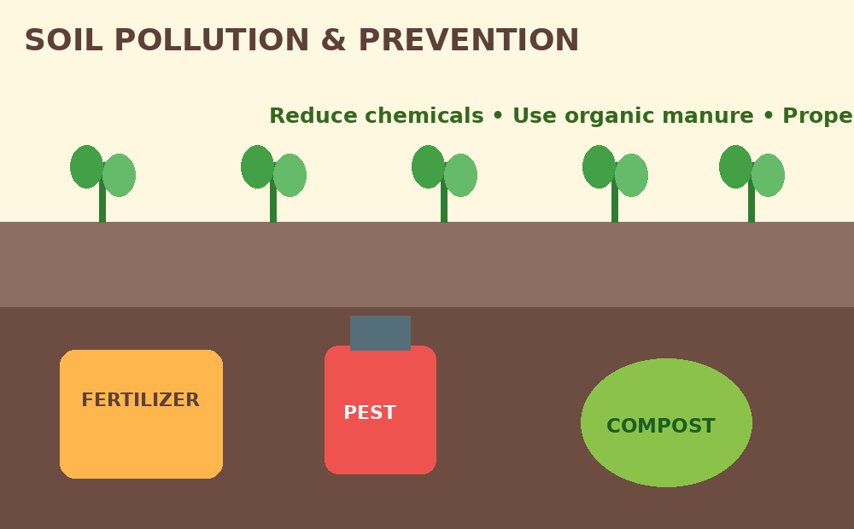
4.13 Soil Pollution
Definition
Soil pollution is the accumulation of harmful substances in soil that reduces soil quality and can affect plants, animals and humans.
Major causes
Industrial waste, municipal solid waste, plastics, excessive fertilizers, pesticides, oil and mining residues.
Why it matters
Pollutants can reduce fertility, contaminate groundwater and enter the food chain.
15

Slide 16
4.13.1–4.13.2 Causes and Effects of Fertilizers, Pesticides & Insecticides
Causes / sources
Effects on soil
• Excess chemical fertilizers
• Repeated pesticide and insecticide use
• Improper disposal of chemical containers
• Industrial and agricultural waste
• Loss of beneficial microorganisms
• Soil acidification or salinity
• Reduced fertility and organic matter
• Toxic residues may persist
Effects on water
Effects on living organisms
• Chemicals can leach into groundwater
• Runoff can contaminate rivers and lakes
• Nutrients may cause eutrophication
• Harm to earthworms and pollinators
• Residues can enter food chains
• Long-term exposure can create ecological and health risks
16

Slide 17
4.13.3 Preventive Measures of Soil Pollution
• Use fertilizers only according to soil-test recommendations.
• Prefer compost, green manure and other organic nutrient sources where suitable.
• Adopt integrated pest management (IPM) and biological control.
• Use the correct pesticide, dose and application method; avoid unnecessary spraying.
• Dispose of pesticide containers and hazardous wastes safely.
• Prevent erosion and maintain vegetation cover.
• Treat industrial and municipal waste before disposal.
✓
Soil testing
✓
Organic manure
✓
IPM
✓
Safe disposal
✓
Erosion control
17

Slide 18
Conclusion
Prevent
Treat
Conserve
Protect
• Water and soil pollution are closely linked to human activities and poor waste management.
• Prevention at the source is usually more effective and economical than cleanup later.
• Treatment technologies, laws, conservation and public participation work together.
• Rainwater harvesting and sustainable farming practices help protect natural resources.
Thank You
18

